Slide 1
STATISTICS AND PROBABILITY IN DECISION MODELING
Naïve Bayes; Confusion Matrix; ROC-AUC
Jagan
28/May/2022

Slide 2
Naïve bayes Classifier
Classification
“Our greatest weakness lies in giving up. The most certain way to succeed is always to try just one more time.” – Thomas Edison
2

Slide 3
Classification Problems with Multiple Classes
Given an article, predict which section of the newspaper (Current News, International, Arts, Sports, Fashion, etc.) it is supposed to go to
Given a photo of a car number plate, identify which state it belongs to
Given an audio clip of a song, identify the genre
Given an email, predict whether it is spam or not spam (a 2-class problem)
“Many of life's failures are people who did not realize how close they were to success when they gave up.” – Thomas Edison
3

Slide 4
Classification Problems
Given certain evidence X, what is the probability that this is from class Y_{i}, i.e., P(Y_{i} | X)
Logistic Regression solves this problem by modelling the probabilistic relationship between X and Y (sigmoid function, linear in X, etc.) directly
“Just because something doesn't do what you planned it to do doesn't mean it's useless.” – Thomas Edison
4

Slide 5
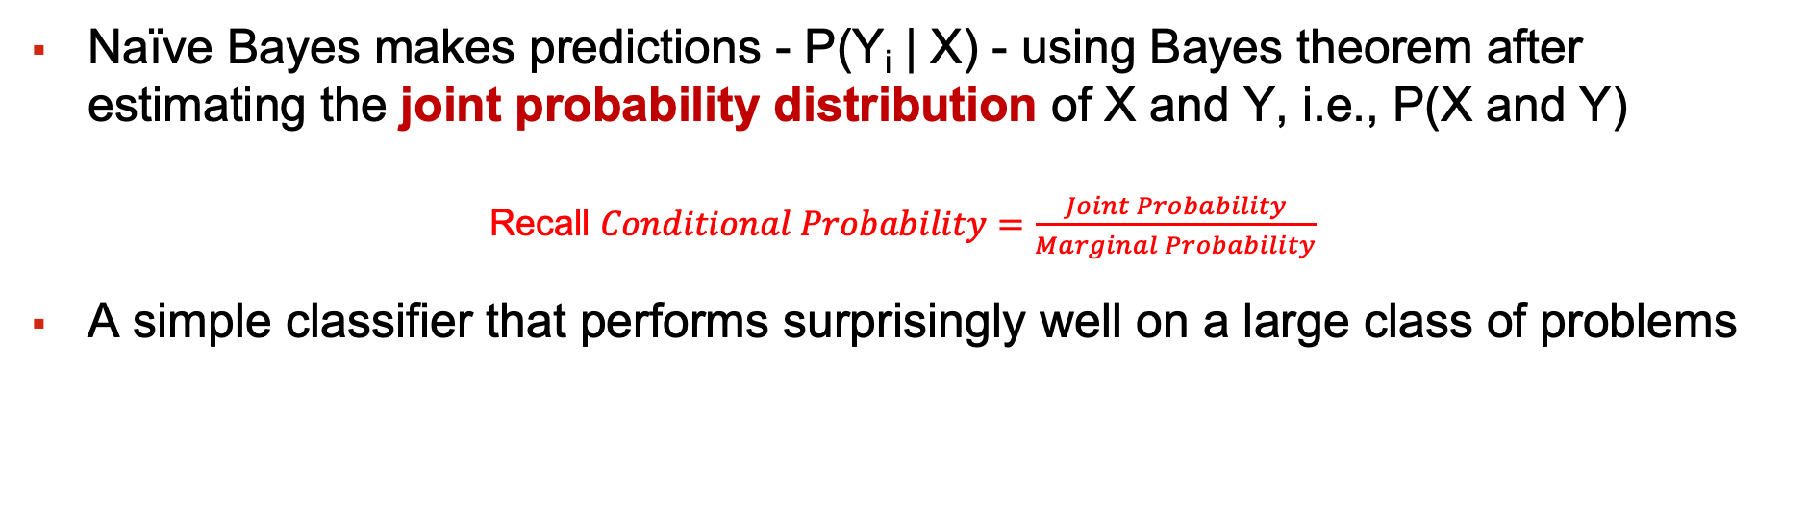
Naïve Bayes Algorithm
Naïve Bayes makes predictions - P(Y_{i} | X) - using Bayes theorem after estimating the joint probability distribution of X and Y, i.e., P(X and Y)
Recall $Conditional Probability=\frac{Joint Probability}{Marginal Probability}$
A simple classifier that performs surprisingly well on a large class of problems
“Show me a thoroughly satisfied man and I will show you a failure.” – Thomas Edison
5

Slide 6
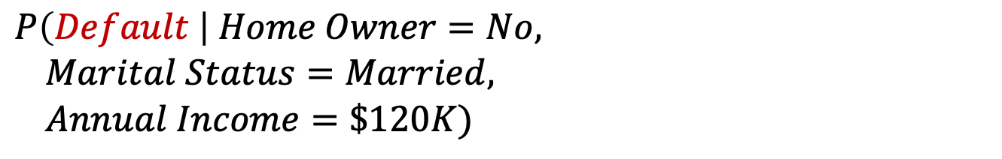
Predicting Loan Default
categorical
categorical
continuous
class
We want to predict whether a person is going to default on loan given they don’t own a home, are married and have an annual income of $120,000, i.e.,
$$P\left(Default \right| Home Owner=No,$$
$Marital Status=Married,$
$Annual Income=\$120K)$
Example from: Introduction to Data Mining, 2nd Edition, Tan, Steinbach, Karpatne and Kumar, Pearson, 2019
“If you accept failure as an opportunity to learn, it will change your whole perspective.” – Catherine Pulsifer
6

Slide 7
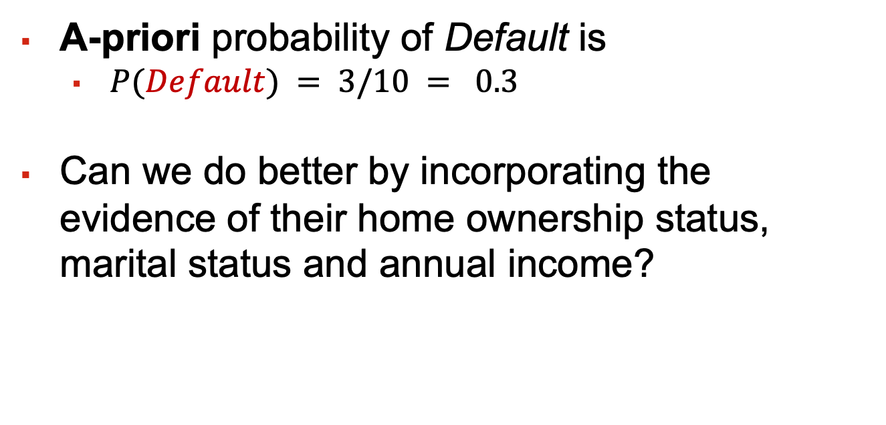
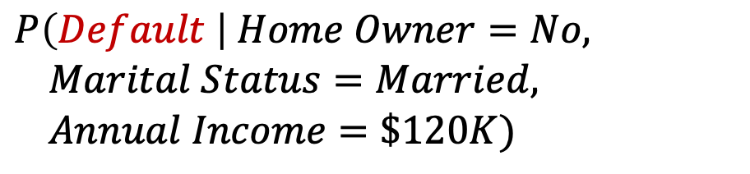
Prior Belief - Simplest Solution
A-priori probability of Default is
$P(Default) = 3/10 = 0.3$
Can we do better by incorporating the evidence of their home ownership status, marital status and annual income?
$$P\left(Default \right| Home Owner=No,$$
$Marital Status=Married,$
$Annual Income=\$120K)$
“The best way to get started is to quit talking and begin doing.” – Walt Disney
7

Slide 8
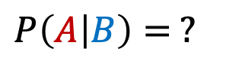

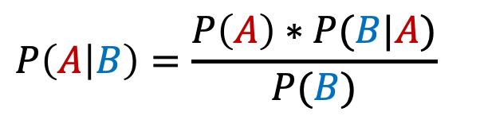

Naïve Bayes Algorithm
$$P\left(A | B\right)=\frac{P\left(A\right)∗P(B|A)}{P(B)}$$
Bayes Theorem
$$P\left(A | B\right)= ?$$
$P\left(Default \right| Home Owner=No, Marital Status=Married,$ $Annual Income=\$120K)$
$$=\frac{P\left(Default\right)∗P(Home Owner=No, Marital Status=Married, Annual Income=\$120K|Default)}{P(Home Owner=No, Marital Status=Married, Annual Income=\$120K)}$$
Naïve Assumption: Conditional probability of each feature, GIVEN the class (aka class-conditional probability), is independent of all other features. It also gives equal importance (weight) to all variables.
Recall: P(A and B) = P(A)*P(B), if A and B are independent
$$P(Home Owner=No, Marital Status=Married, Annual Income=\$120K|Default)$$
$$=P\left(Home Owner=No | Default\right)∗P\left(Marital Status=Married | Default\right)∗P\left(Annual Income=\$120K | Default\right)$$
“The pessimist sees difficulty in every opportunity. The optimist sees opportunity in every difficulty.” – Winston Churchill
8

Slide 9
Naïve Bayes Algorithm
(1)
$P\left(Default \right| Home Owner=No, Marital Status=Married,$ $Annual Income=\$120K)$
$$=\frac{P\left(Default\right)∗P(Home Owner=No, Marital Status=Married, Annual Income=\$120K|Default)}{P(Home Owner=No, Marital Status=Married, Annual Income=\$120K)}$$
$$=\frac{P\left(Default\right)∗P\left(Home Owner=No | Default\right)∗P\left(Marital Status=Married | Default\right)∗P(Annual Income=\$120K|Default)}{P(Home Owner=No, Marital Status=Married, Annual Income=\$120K)}$$
Likewise, probability of not defaulting under the same conditions is computed. If probability of default is higher than probability of not defaulting, then the class default is assigned; else, class non-default is assigned.
(2)
$P\left(Non−Default \right| Home Owner=No, Marital Status=Married,$ $Annual Income=\$120K)$
$$=\frac{P\left(Non−Default\right)∗P\left(Home Owner=No | Non−Default\right)∗P\left(Marital Status=Married | Non−Default\right)∗P(Annual Income=\$120K|Non−Default)}{P(Home Owner=No, Marital Status=Married, Annual Income=\$120K)}$$
Since the denominator is the same in both calculations, it is sufficient to compare the numerator to know which probability is higher.
“Don’t let yesterday take up too much of today.” – Will Rogers
9

Slide 10
Estimate Probabilities from Data
Class: Default = Yes
A-priori: P(Default) | 3/10 = 0.3
P(Home Owner = No | Default) | 3/3 = 1
P(Marital Status = Married | Default) | 0/3 = 0
P(Annual Income = $120K | Default) | ? (Continuous Variable)
Class: Default = No
A-priori: P(Non-Default) | 7/10 = 0.7
P(Home Owner = No | Non-Default) | 4/7
P(Marital Status = Married | Non-Default) | 4/7
P(Annual Income = $120K | Non-Default) | ? (Continuous Variable)
The a-posteriori probability of default = Yes computes to 0 and so, the instance is classified as non-default. It is quite possible that if a similar record is non-existent in the other class, even that can compute to 0, leading to no classification. In addition to this, we need to deal with continuous variables.
“You learn more from failure than from success. Don’t let it stop you. Failure builds character.” – Anonymous
10

Slide 11
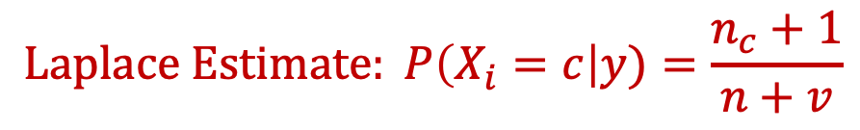

Handling Zero Conditional Probabilities
If even one of the conditional probabilities is zero, the entire expression becomes 0.
Laplace Estimate is used to address this issue.
n: number of training instances belonging to class y
n_{c}: number of instances with X_{i} = c and Y = y
v: total number of attribute values that X_{i} can take
$$Laplace Estimate: P\left(X_{i}=c\right|y)=\frac{n_{c}+1}{n+v}$$
In this example, $X_{i} is Marital Status$
$c is Married$, $y is Yes for Defaulted Borrower$
$n_{c} is 0,n is 3$ and $v is 3 (Single, Married, Divorced)$
$$Laplace Estimate: P\left(Marital Status=Married\right|Default)=\frac{0+1}{3+3}=\frac{1}{6}$$
Source: Introduction to Data Mining, 2nd Edition, Tan, Steinbach, Karpatne and Kumar, Pearson, 2019
“It’s not whether you get knocked down, it’s whether you get up.” – Vince Lombardi
11

Slide 12
Handling Continuous Attributes
For continuous attributes:
Discretization: Partition the range into bins:
Replace continuous value with bin value
Attribute changed from continuous to ordinal
Probability density estimation:
Assume attribute follows a normal distribution
Use data to estimate parameters of distribution (e.g., mean and standard deviation)
Once probability distribution is known, use it to estimate the conditional probability P(X_{i}|Y)
Source: Introduction to Data Mining, 2nd Edition, Tan, Steinbach, Karpatne and Kumar, Pearson, 2019
“If you are working on something that you really care about, you don’t have to be pushed. The vision pulls you.” – Steve Jobs
12

Slide 13
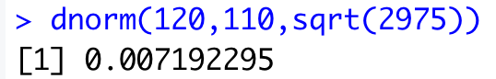
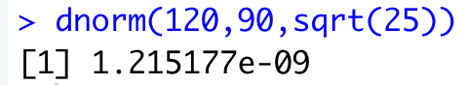
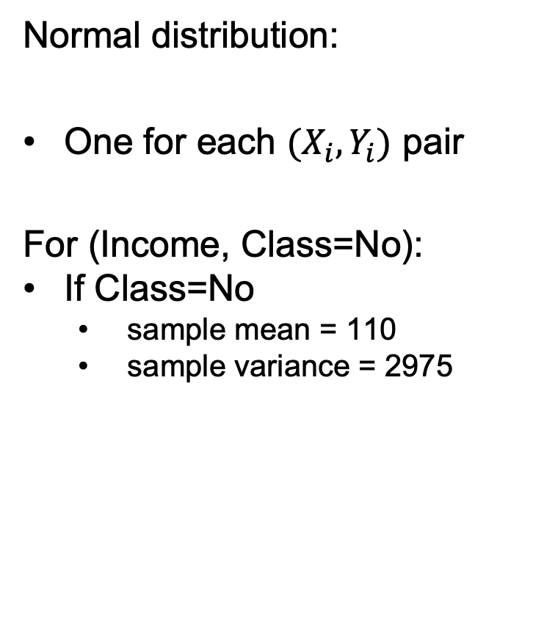
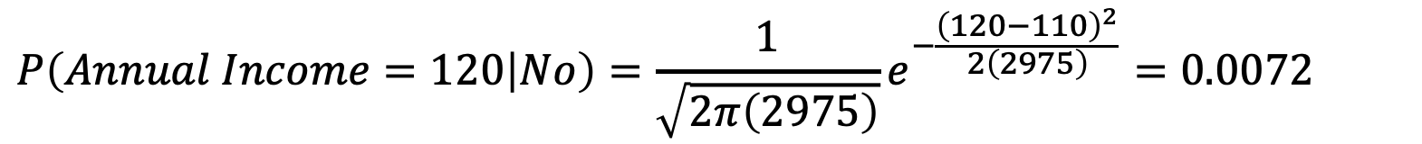
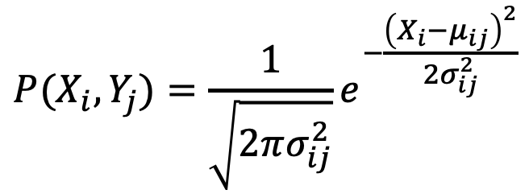
Handling Continuous Attributes
$$P(X_{i},Y_{j})=\frac{1}{\sqrt{2πσ_{ij}^{2}}}e^{−\frac{{\left(X_{i}−μ_{ij}\right)}^{2}}{2σ_{ij}^{2}}}$$
Normal distribution:
One for each $(X_{i},Y_{i})$ pair
For (Income, Class=No):
If Class=No
sample mean = 110
sample variance = 2975
For (Income, Class=Yes):
If Class=Yes
sample mean = 90
sample variance = 25
$$P\left(Annual Income=120 | No\right)=\frac{1}{\sqrt{2π\left(2975\right)}}e^{−\frac{{\left(120−110\right)}^{2}}{2\left(2975\right)}}=0.0072$$
“People who are crazy enough to think they can change the world, are the ones who do.” – Rob Siltanen
13

Slide 14
Estimate Probabilities from Data
Class: Default = Yes (using Laplace estimate)
A-priori: P(Default) | 3/10 = 0.3
P(Home Owner = No | Default) | (3+1)/(3+2) = 4/5
P(Marital Status = Married | Default) | (0+1)/(3+3) = 1/6
P(Annual Income = $120K | Default) | 1.2 x 10⁻⁹
Class: Default = No (using Laplace estimate)
A-priori: P(Non-Default) | 7/10 = 0.7
P(Home Owner = No | Non-Default) | (4+1)/(7+2) = 5/9
P(Marital Status = Married | Non-Default) | (4+1)/(7+3) = 1/2
P(Annual Income = $120K | Non-Default) | 0.0072
The a-posteriori probability of default = No is larger than the a-posteriori probability of default = yes. Hence, this instance will be classified as No.
“Failure will never overtake me if my determination to succeed is strong enough.” – Og Mandino
14

Slide 15
Naïve Bayes Algorithm - Summary
The key assumption of independence of features is almost never true
Still Naïve Bayes does surprisingly well in a lot of situations
It works best when all the predictor variables are categorical variables
Numeric variables can be handled either by discretizing them or by assuming a distribution, typically Gaussian.
Very frequently used in text mining, character image analysis problems where the independence assumption has greater validity
“We may encounter many defeats but we must not be defeated.” – Maya Angelou
15

Slide 16
How Good is Your Classification?
Confusion Matrix
“Knowing is not enough; we must apply. Wishing is not enough; we must do.” – Johann Wolfgang von Goethe
16

Slide 17
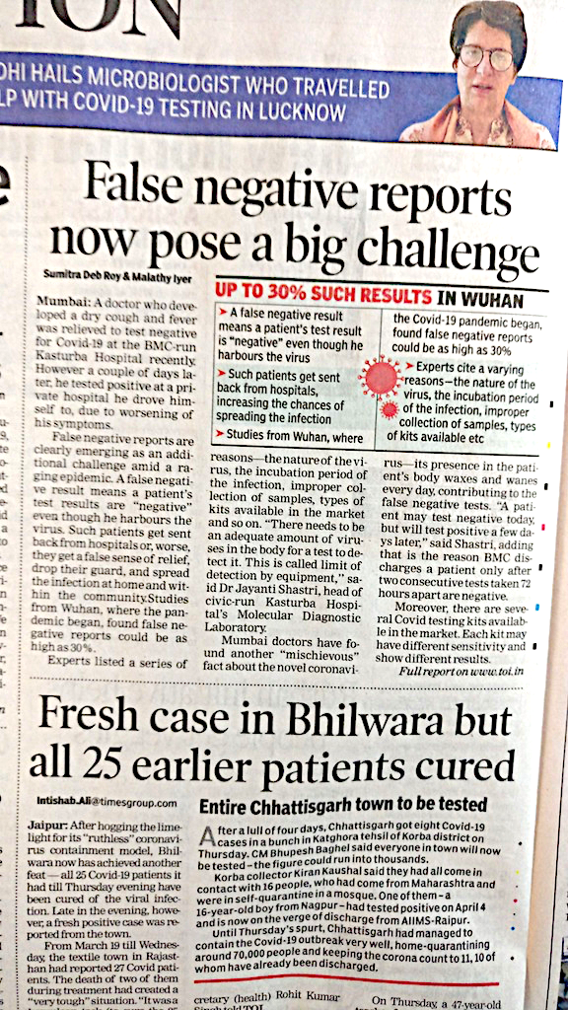
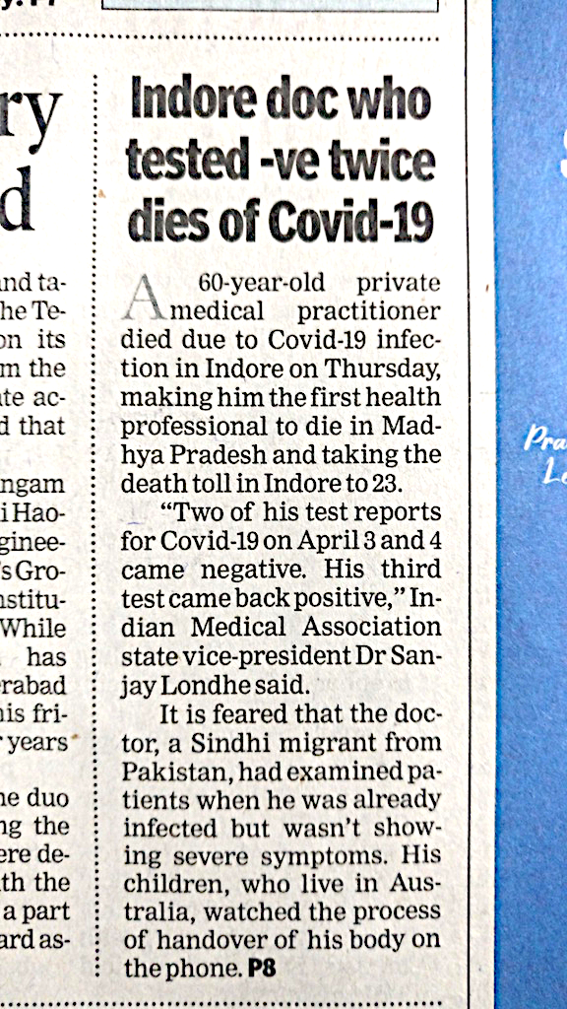
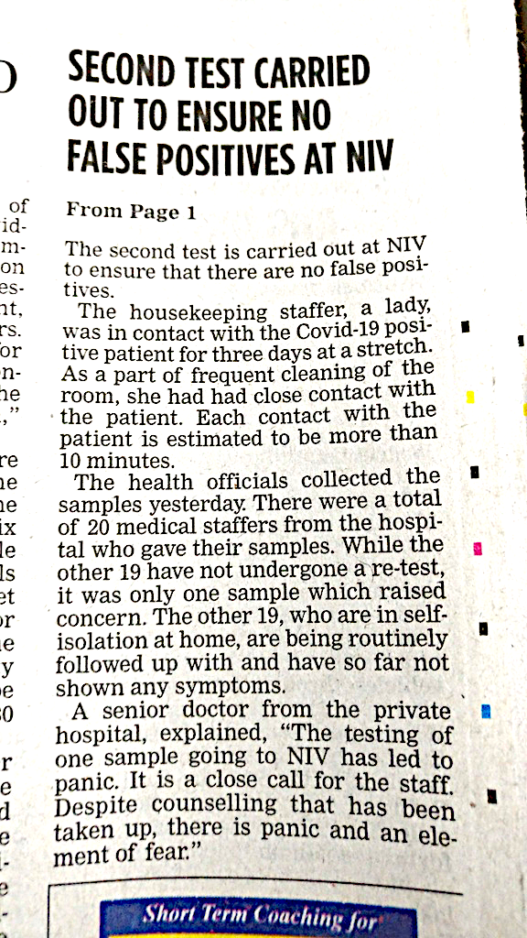

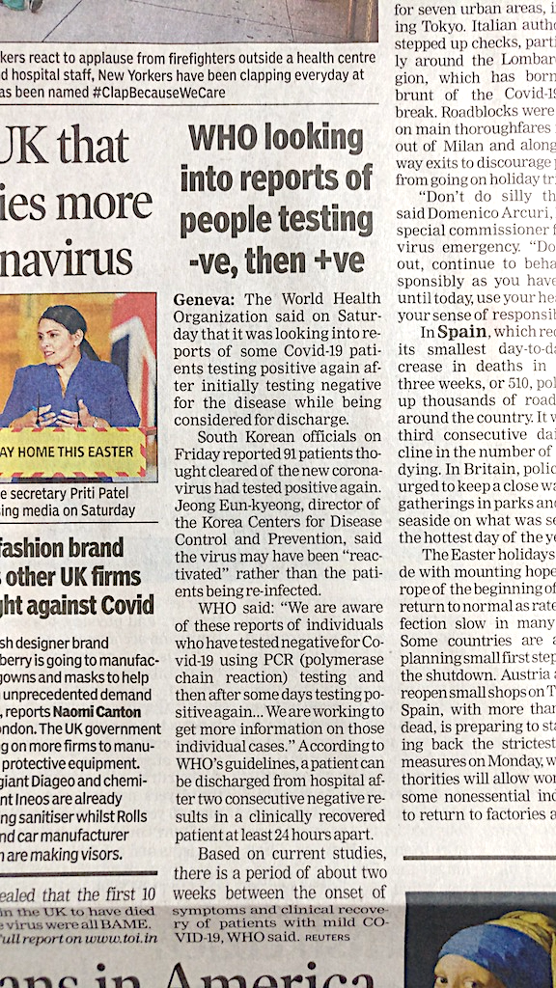
Confusion Matrix
Recall Logistic Regression Classification Case
10-year CHD risk |  | Predicted |  | Total
 |  | Positive | Negative
Actual | Positive | 30 | 357 | 387
 | Negative | 9 | 2170 | 2179
Total |  | 39 | 2527 | 2566
 |  | Predicted
 |  | Positive | Negative
Actual | Positive | True +ve | False –ve
 | Negative | False +ve | True –ve
“We generate fears while we sit. We overcome them by action.” – Henry Link
17

Slide 18
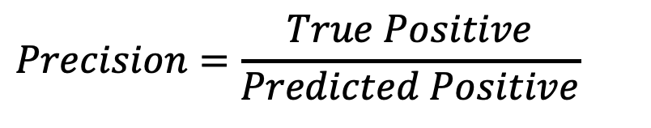
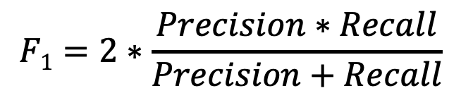
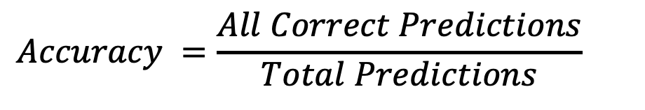
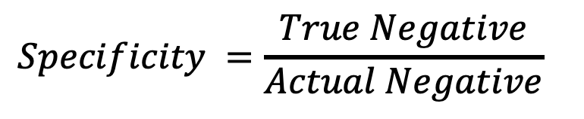
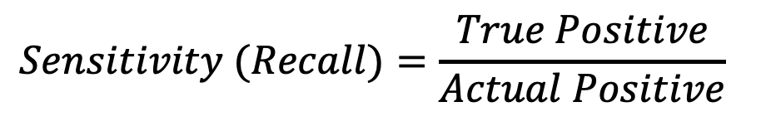
Confusion Matrix
 |  | Predicted
 |  | Positive | Negative
Actual | Positive | True +ve | False –ve | Recall/Sensitivity/True Positive Rate Minimize False –ve
 | Negative | False +ve | True –ve | Specificity/True Negative Rate Minimize False +ve
 |  | Precision Minimize False +ve |  | Accuracy, F₁ measure
$$Sensitivity (Recall)=\frac{True Positive}{Actual Positive}$$
$$Specificity =\frac{True Negative}{Actual Negative}$$
$$Precision=\frac{True Positive}{Predicted Positive}$$
$$Accuracy =\frac{All Correct Predictions}{Total Predictions}$$
$$F1=2∗\frac{Precision∗Recall}{Precision+Recall}$$
Higher the numbers, better they are.
“Security is mostly a superstition. Life is either a daring adventure or nothing.” – Helen Keller
18

Slide 19
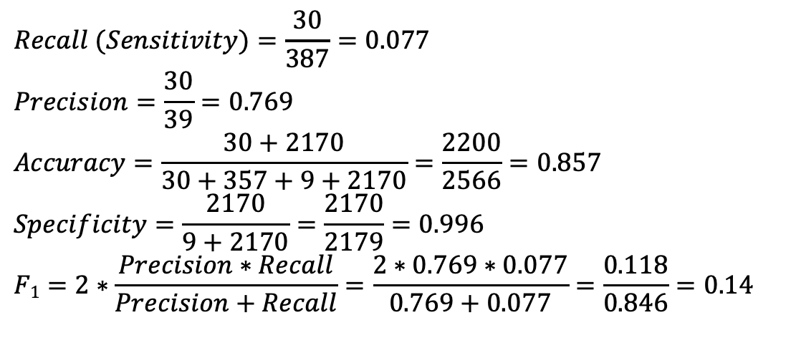
Confusion Matrix
$$Recall (Sensitivity)=\frac{30}{387}=0.077$$
$$Precision=\frac{30}{39}=0.769$$
$$Accuracy=\frac{30+2170}{30+357+9+2170}=\frac{2200}{2566}=0.857$$
$$Specificity=\frac{2170}{9+2170}=\frac{2170}{2179}=0.996$$
$$F1=2∗\frac{Precision∗Recall}{Precision+Recall}=\frac{2∗0.769∗0.077}{0.769+0.077}=\frac{0.118}{0.846}=0.14$$
10-year CHD risk |  | Predicted |  | Total
 |  | Positive | Negative
Actual | Positive | 30 | 357 | 387
 | Negative | 9 | 2170 | 2179
Total |  | 39 | 2527 | 2566
In this business context, what is more important – Precision, Recall or both?
Thought Process: Determine what is more harmful in the context of the business problem - False Positives, False Negatives or both.
False Positive (impacts Precision): A person is predicted as high risk but does not have CHD.
False Negative (impacts Recall): A person is predicted as low risk but has CHD.
False negatives miss actual heart patients and hence Recall is more important to improve.
“The man who has confidence in himself gains the confidence of others.” – Hasidic Proverb
19

Slide 20
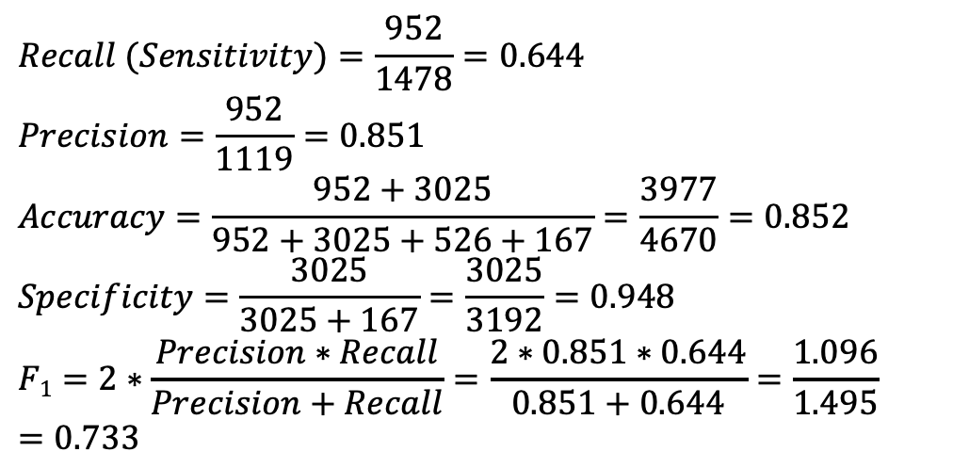
Confusion Matrix
$$Recall (Sensitivity)=\frac{952}{1478}=0.644$$
$$Precision=\frac{952}{1119}=0.851$$
$$Accuracy=\frac{952+3025}{952+3025+526+167}=\frac{3977}{4670}=0.852$$
$$Specificity=\frac{3025}{3025+167}=\frac{3025}{3192}=0.948$$
$$F1=2∗\frac{Precision∗Recall}{Precision+Recall}=\frac{2∗0.851∗0.644}{0.851+0.644}=\frac{1.096}{1.495}=0.733$$
Spam filtering |  | Predicted |  | Total
 |  | Positive | Negative
Actual | Positive | 952 | 526 | 1478
 | Negative | 167 | 3025 | 3192
Total |  | 1119 | 3551 | 4670
Which measure(s) is/are more important?
False Positive: Mail is predicted as spam but is not.
False Negative: Mail is predicted as “not spam” but is spam.
False positives may cause important mails to be missed and hence Precision is more important to improve. Of course, too many false negatives will make the spam filter ineffective as well.
“The only limit to our realization of tomorrow will be our doubts of today.” – Franklin D Roosevelt
20

Slide 21
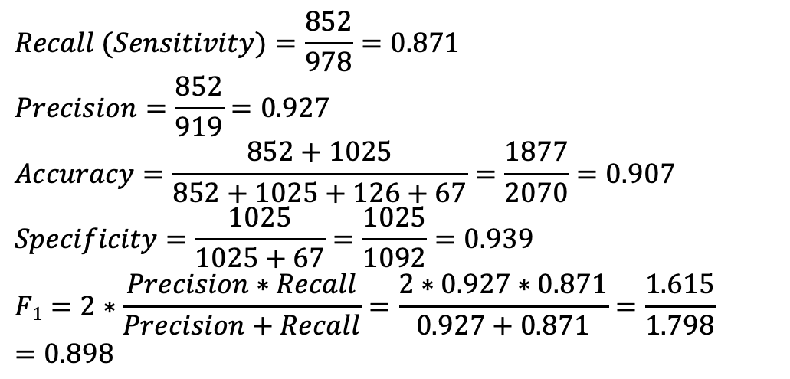
Confusion Matrix
$$Recall (Sensitivity)=\frac{852}{978}=0.871$$
$$Precision=\frac{852}{919}=0.927$$
$$Accuracy=\frac{852+1025}{852+1025+126+67}=\frac{1877}{2070}=0.907$$
$$Specificity=\frac{1025}{1025+67}=\frac{1025}{1092}=0.939$$
$$F1=2∗\frac{Precision∗Recall}{Precision+Recall}=\frac{2∗0.927∗0.871}{0.927+0.871}=\frac{1.615}{1.798}=0.898$$
Flight delay prediction |  | Predicted |  | Total
 |  | Positive | Negative
Actual | Positive | 852 | 126 | 978
 | Negative | 67 | 1025 | 1092
Total |  | 919 | 1151 | 2070
Which measure(s) is/are more important?
False Positive: Flight is predicted to be delayed but it is not.
False Negative: Flight is predicted to be on time but is delayed.
False positives may cause congestion at gates and false negatives make it difficult to plan aircraft occupancy at gates. Both are equally bad and hence F₁ is important to track. Of course, both Precision and Recall will also need to be watched.
“Creativity is intelligence having fun.” – Albert Einstein
21

Slide 22
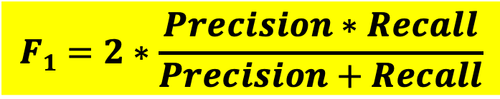
Confusion Matrix
$$F1=2∗\frac{Precision∗Recall}{Precision+Recall}$$
What is the F₁ score if Precision is 80% and Recall is 25%?
0.38
What is the F₁ score if Precision is 70% and Recall is 30%?
0.42
F-score helps determine how much of a tradeoff between Precision and Recall is worthwhile when both Precision and Recall are equally important. Higher F-score “indicates” a better model.
“What you lack in talent can be made up with desire, hustle and giving 110% all the time.” – Don Zimmer
22

Slide 23
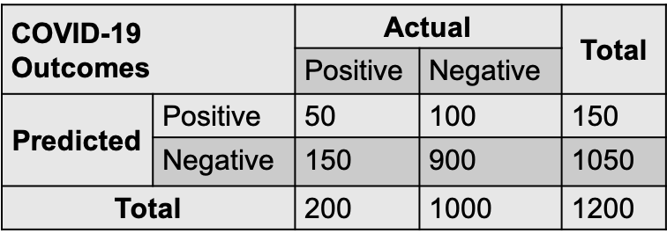
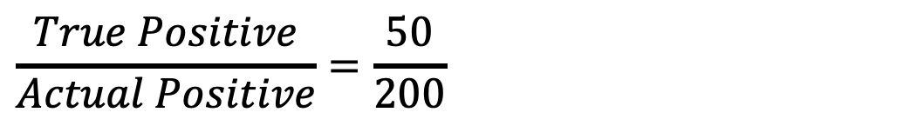
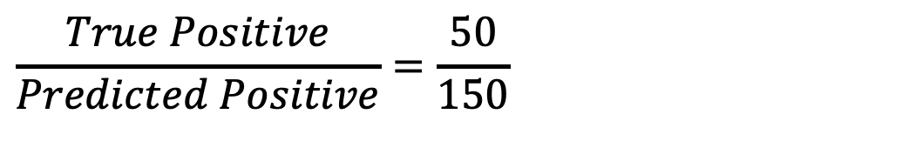
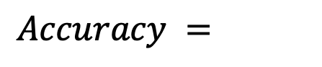
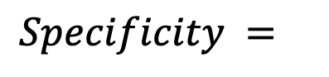
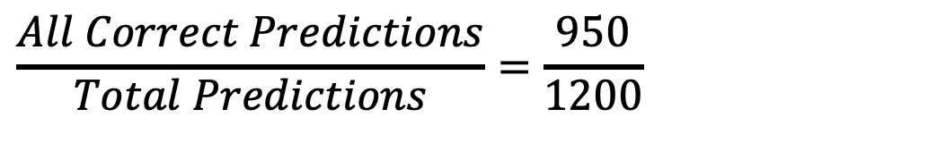
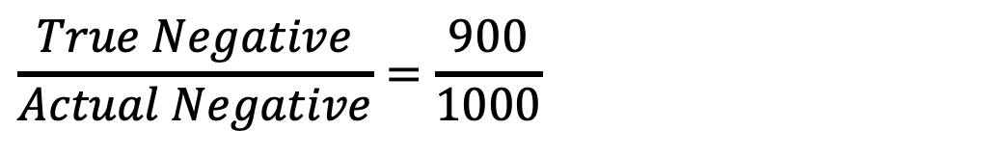
Attention Check
$$\frac{True Positive}{Predicted Positive}=\frac{50}{150}$$
$$Precision=$$
$$\frac{True Positive}{Actual Positive}=\frac{50}{200}$$
$$Sensitivity (Recall)=$$
$$\frac{True Negative}{Actual Negative}=\frac{900}{1000}$$
$$Specificity =$$
$$\frac{All Correct Predictions}{Total Predictions}=\frac{950}{1200}$$
$$Accuracy =$$
“Do what you can with all you have, wherever you are.” – Theodore Roosevelt
23

Slide 24
How Good is Your Classification?
ROC Curve and AUC
“You are never too old to set another goal or to dream a new dream.” – C S Lewis
24

Slide 25
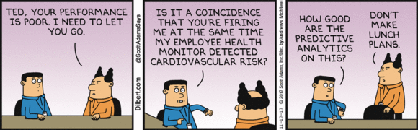
Case Study – Predicting Coronary Heart Disease (CHD)
Training Set
Results
Accuracy in training set = 2198/2566 = 85.6%
Accuracy in testing set = 927/1092 = 84.9%
Accuracy is affected by imbalance between positives and negatives.
There is a trade-off between sensitivity and specificity.
10-year CHD risk |  | Predicted
Actual |  | True | False
 | True | 29 | 358
 | False | 10 | 2169
Testing Set
10-year CHD risk |  | Predicted
Actual |  | True | False
 | True | 12 | 158
 | False | 7 | 915
“To see what is right and not do it is a lack of courage.” – Confucius
25

Slide 26
ROC Curves and AUC
ROC – Receiver Operating Characteristics
AUC – Area Under the ROC Curve
“Reading is to the mind, as exercise is to the body.” – Brian Tracy
26

Slide 27
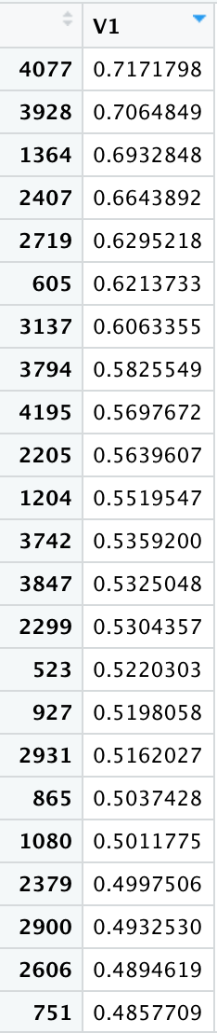
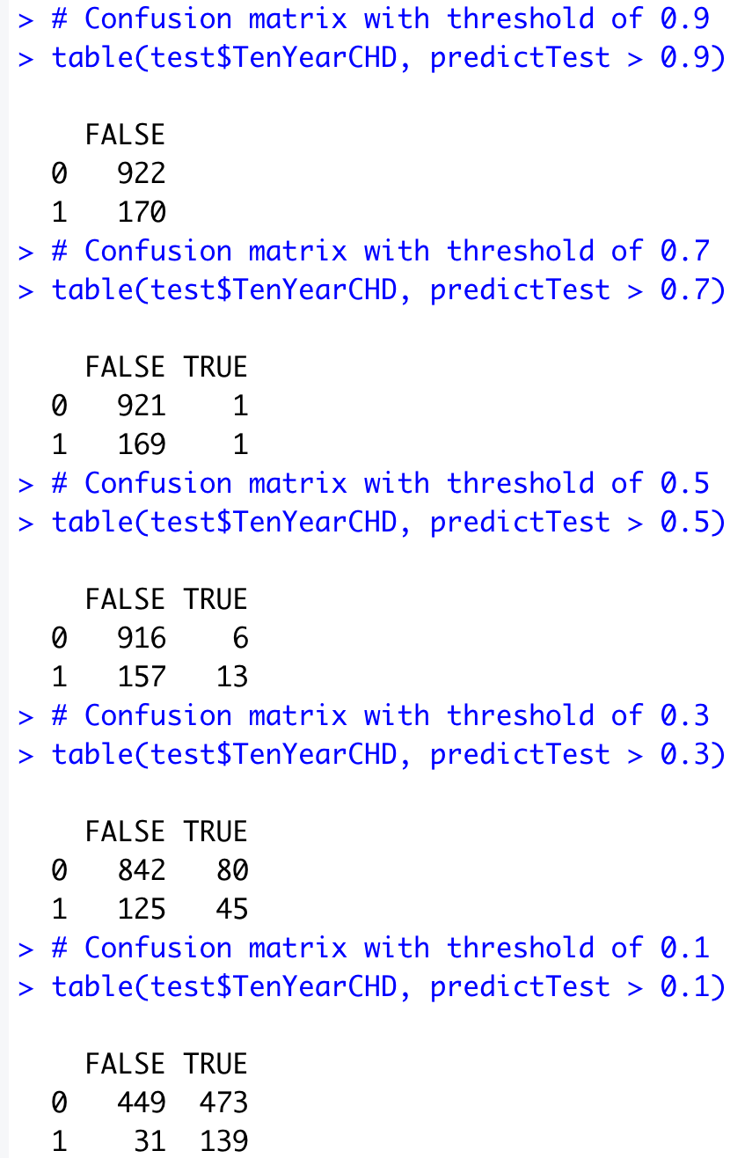
ROC Curves and AUC
ROC – Plot of True Positive Rate vs False Positive Rate, i.e., Sensitivity vs 1-Specificity
CHD
1
0
1
0
1
1
1
0
1
0
1
0
1
1
1
0
1
Threshold at 70% probability
Did they suffer a heart attack or stroke in 10 years or not?
Predicted probability of suffering a heart attack in 10 years
Threshold at 50% probability
“The future belongs to the competent. Get good, get better, be the best!.” – Brian Tracy
27

Slide 28
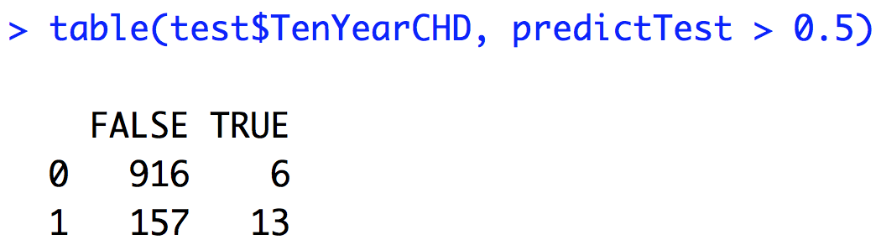
ROC Curves and AUC
ROC – Plot of True Positive Rate vs False Positive Rate, i.e., Sensitivity vs 1-Specificity
Actual Counts
Without CHD (Negatives): 922
With CHD (Positives): 170
Probability Threshold for Discriminating Between High Risk and Low Risk of Having Ten Year CHD | True Positives | False Positives | True Negatives | False Negatives
0.9 | 0 | 0 | 922 | 170
0.7 | 1 | 1 | 921 | 169
0.5 | 13 | 6 | 916 | 157
0.3 | 45 | 80 | 842 | 125
0.1 | 139 | 473 | 449 | 31
“For every reason it’s not possible, there are hundreds of people who have faced the same circumstances and succeeded.” – Jack Canfield
28

Slide 29
ROC Curves and AUC
ROC – Plot of True Positive Rate vs False Positive Rate, i.e., Sensitivity vs 1-Specificity
Actual Counts
Without CHD (Negatives): 922
With CHD (Positives): 170
Sensitivity
Specificity
Probability Threshold for Discriminating Between High Risk and Low Risk of Having Ten Year CHD | True Positive Rate | False Positive Rate | True Negative Rate | False Negative Rate
0.9 | 0/170 | 0/922 | 922/922 | 170/170
0.7 | 1/170 | 1/922 | 921/922 | 169/170
0.5 | 13/170 | 6/922 | 916/922 | 157/170
0.3 | 45/170 | 80/922 | 842/922 | 125/170
0.1 | 139/170 | 473/922 | 449/922 | 31/170
ROC Curve
“Things work out best for those who make the best of how things work out.” – John Wooden
29

Slide 30
ROC Curves and AUC
ROC – Plot of True Positive Rate vs False Positive Rate, i.e., Sensitivity vs 1-Specificity
Sensitivity
1-Specificity
Probability Threshold for Discriminating Between High Risk and Low Risk of Having Ten Year CHD | True Positive Rate | False Positive Rate
0.9 | 0/170 | 0/922
0.7 | 1/170 | 1/922
0.5 | 13/170 | 6/922
0.3 | 45/170 | 80/922
0.1 | 139/170 | 473/922
P(Predicting CHD | Have CHD)
P(Predicting CHD | Do Not Have CHD)
ROC Curve
“A room without books is like a body without a soul.” – Marcus Tullius Cicero
30

Slide 31
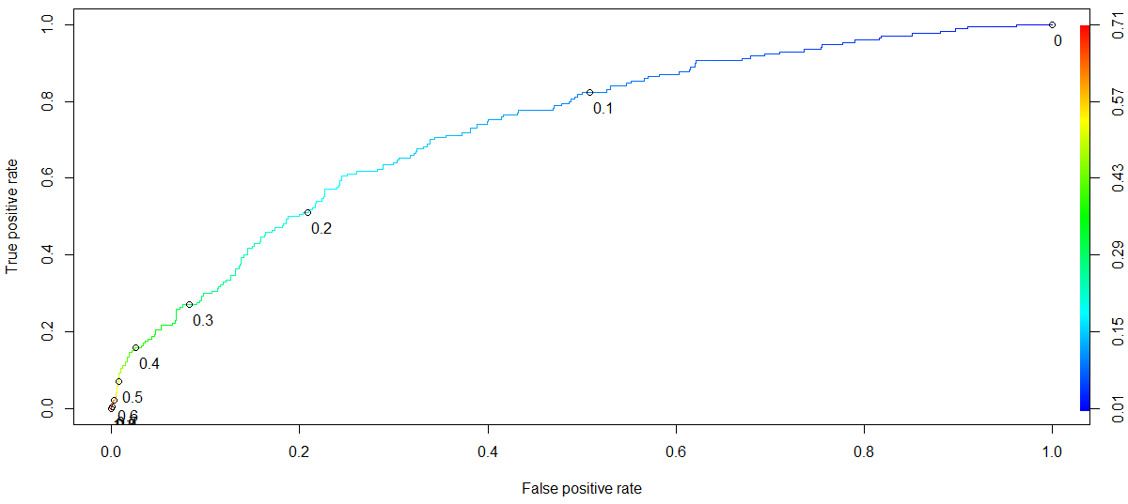
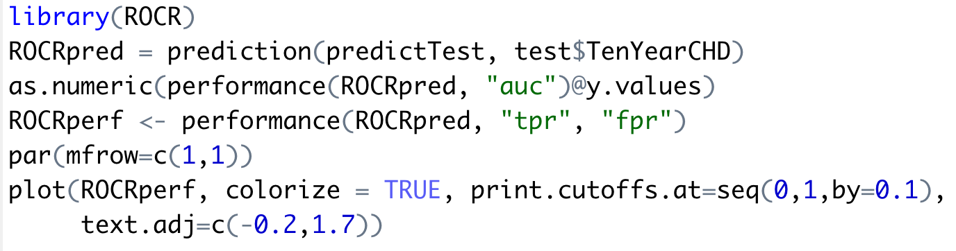
ROC Curves and AUC
ROC – Plot of True Positive Rate vs False Positive Rate, i.e., Sensitivity vs 1-Specificity
“I think goals should never be easy. They should force you to work, even if they are uncomfortable at the time.” – Michael Phelps
31

Slide 32
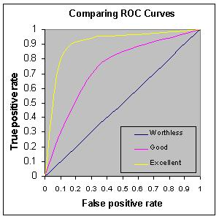
ROC Curves and AUC
Rough rule of thumb:
0.90 -1.0 = Excellent
0.80 – 0.90 = Good
0.70 – 0.80 = Fair
0.60 – 0.70 = Poor
0.50 – 0.60 = Fail
<0.50 – You are better off doing a coin toss than working hard to build a model ☺
“Today’s accomplishments were yesterday’s impossibilities.” – Robert H Schuller
32

Slide 33
ROC Curves and AUC
AUC_{model 1} = 73.2%
AUC_{model 2} = 73.7%
Coloured line represents Model 2 (the simpler one) and the black line represents Model 1 (the original one)
The models do a fair job of discrimination between high risk and low risk people.
AUC is useful for comparing different models.
“The only way to do great work is to love what you do. If you haven’t found it yet, keep looking. Don’t settle.” – Steve Jobs
33

Slide 34
How Good is Your Classification?
Gains and Lift Charts
“You don’t have to be great to start, but you have to start to be great.” – Zig Ziglar
34

Slide 35
Gains and Lift Charts
In some business problems, it is not good enough to just classify.
For example, in direct mail or phone marketing campaigns, where it costs money to send a mail or make a call to each prospect, it is better to be able to rank the prospective buyers by their probability to buy. That way, you can order them and start calling or mailing them in their decreasing order of propensity to buy.
In credit risk modelling, you might want to target only certain customers for offering a new loan product.
Lift is a measure of the effectiveness of a predictive model calculated as the ratio between the results obtained with and without the predictive model (random selection).
“A clear vision, backed by definite plans, gives you a tremendous feeling of confidence and personal power.” – Brian Tracy
35

Slide 36
Gains and Lift Charts
A company sends mail catalogs to prospective buyers. It costs the company $1 to print and mail one catalog.
From past data, they know the response rate is 5%, i.e., if 100,000 prospective customers are contacted, 5000 buy.
This means that if there is no model and the company randomly contacts the prospects, they will have the following result.
No. of customers contacted | No. of responses
10000 | 500
20000 | 1000
30000 | 1500
. | .
. | .
. | .
100000 | 5000
“Integrity is the most valuable and respected quality of leadership. Always keep your word.” – Brian Tracy
36

Slide 37
Gains and Lift Charts
With a predictive model, where the model assigns a probability to each customer, the customers are ordered and divided into deciles (or any other quantiles). They are then called in decreasing order of probability to buy.
Cost ($) | Decile contacted | Cumulative responses
10000 | 10 (top decile) | 1500
20000 | 9 | 2500
30000 | 8 | 3500
40000 | 7 | 4200
50000 | 6 | 4500
60000 | 5 | 4700
70000 | 4 | 4850
80000 | 3 | 4925
90000 | 2 | 4975
100000 | 1 | 5000
“Leadership is the ability to get extraordinary achievement from ordinary people.” – Brian Tracy
37

Slide 38
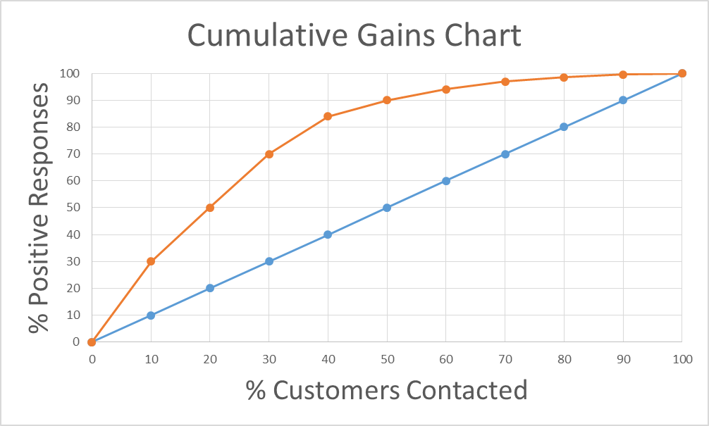
Gains and Lift Charts
Lift Curve
Baseline
Cost ($) | Decile contacted | Cumulative responses
10000 | 10 (top decile) | 1500
20000 | 9 | 2500
30000 | 8 | 3500
40000 | 7 | 4200
50000 | 6 | 4500
60000 | 5 | 4700
70000 | 4 | 4850
80000 | 3 | 4925
90000 | 2 | 4975
100000 | 1 | 5000
“Leaders set high standards. Refuse to tolerate mediocrity or poor performance.” – Brian Tracy
38

Slide 39
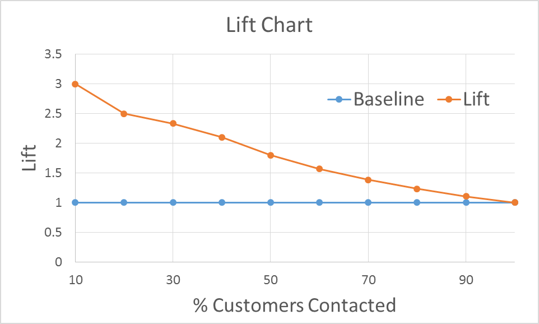
Gains and Lift Charts
Max lift of 3 at the top decile.
Model advantage diminishes as more customers are contacted, especially in lower deciles.
Useful to compare different models.
“Clarity is the key to effective leadership. What are your goals?” – Brian Tracy
39

Slide 40
Learning Outcomes of Today’s Session
When revising the material, keep in mind that if you can confidently and fluently answer the below, you have understood everything that needs to be understood from today’s session – these are the expected outcomes from your learning today. First revise (material and videos of the class) and then ask questions.
Be able to:
explain Naïve Bayes algorithm
explain the naïve assumption
explain the usage of marginal, conditional probabilities to compute posterior probabilities in Naïve Bayes algorithm
explain the A-priori probabilities and conditional probabilities for each attribute with respective to target class category
explain how to evaluate classification models using testing/validation data
interpret Confusion Matrix
define and compute Precision, Recall, Specificity, Accuracy and F1 Score.
explain the significance of ROC curves and AUC in model evaluation and selection
explain Lift and Gains Charts and their use
compute a Lift Chart from the Gains Chart data
“A negative mind will never give you a positive life.” – Anonymous
40

Slide 41






Email: info@insofe.edu.in
Website: www.insofe.edu.in
Follow us on Social Media:
/insofeglobal/
/school/insofe/
/INSOFEedu
/insofe_global/
/InsofeVideos
This presentation may contain references to findings of various reports available in the public domain. INSOFE makes no representation as to their accuracy or that the organization subscribes to those findings.

